Slide 1
Event Name / Date
The Value of BIM for Owners:
Save Time and Money During the Building Lifecycle
Presenter Name
Title

Slide 2
The cost to owners
Poor use of data coupled with highly fragmented teams cost the US capital facilities industry $15.8 billion annually¹
Owner’s burden is about 2/3 of those costs during ongoing operations.
$15.8 billion
annually
Notes:
Owners shoulder 2/3 of the ongoing operating cost (estimated at $15.8 billion annually) that are a result of poor data and highly fragmented teams.
¹ Michael P. Gallaher, Alan C. O’Connor, John L. Dettbarn, Jr., and Linda T. Gilday, “Cost Analysis of Inadequate Interoperability in the U.S. Capital Facilities Industry”, August 2004

Slide 3
Problems owners face
Over 60% of major capital programs fail to meet cost
and schedule targets¹
30% of construction cost is rework²
55% of maintenance remains reactive³
Notes:
Owners face several challenges when trying to contain costs and deliver on schedule.
¹ Independent Project Analysis Institute
² Rethinking Construction, John Egan
3 US Department of Energy, Operations and Maintenance Best Practices Guide, August 2010.

Slide 4
Building Information Modeling (BIM)
A foundational, intelligent model-based process for business and industry transformation
Uses 3D models to capture, explore, and maintain consistent and coordinated planning, design, construction, and operational data
Provides greater project insight for cost, schedule, and constructability
Uses and shares the same consistent data whether you’re at your desk or in the field
Enables prompt response to change with processes that are smarter and faster
Notes:
Building Information Modeling (BIM) is a process that begins with the creation of an intelligent 3D model to capture, explore, and maintain planning, design, construction, and operational data in order to better inform decision making for building and infrastructure projects. The information in the model remains coordinated and consistent an
Create and use a data-rich 3D model to improve how buildings and infrastructure are planned, designed, built, and managed
Provides greater project insight on things like cost, schedule, and constructability
Share and use the same consistent data whether you’re at your desk or in the field
Respond quickly to change with processes that are smarter and faster
d is available for simulation, analysis, collaboration, and communication throughout the lifecycle of the project.

Slide 5
BIM empowers owners
Using BIM, owners can:
Improve building quality
Significantly reduce building lifecycle costs
Better understand design projects from beginning to end
Optimize operational efficiencies
Increase occupancy and use rates
Transparency
BIM
Quality
Efficiency
Notes:
BIM allows owners to take control and harness the power of the Era of Connection.
BIM increases transparency, quality, and efficiency so owners can:
Improve building quality
Significantly reduce building lifecycle costs
Better understand design projects from beginning to end
Optimize operational efficiencies
Increase occupancy and use rates

Slide 6
Top BIM benefits for owners
Top internal business benefits of using BIM for construction projects for owners
Reduced document errors and omissions
Reduced rework
Reduced construction cost
Reduce project duration
Fewer claims/litigation
Notes:
A McGraw-Hill survey found that owners enjoy a reduction in document errors and omissions; rework; costs; project duration; and claims.
Source: McGraw-Hill Construction, 2012

Slide 7
How BIM saves owners’ time and money throughout the building lifecycle
Design
Construction
Management
Notes:
BIM saves time and money throughout all phases of design, construction, and ongoing property management.

Slide 8
BIM saves time and money in the design phase
Area
Description
Example
Conceptual design
Quickly iterate on design elements including building form, sustainability, client requests, municipal regulations, budget, and more.
Conduct analyses and simulation
The Beck Group created 100 visualizations for a church in Seoul and adjusted the shape of the building to appear curved, but with flat glass, saving over $1 million on glazing and mullions, and 1,000 hours of design time
Sustainable
building design
Complete energy analysis early in the design stage to reduce ongoing energy consumption
Using BIM to evaluate design scenarios for energy savings, NASA’s 50,000’ building in Silicon Valley yielded features such as a steel-frame exoskeleton, geothermal wells, natural ventilation, wastewater treatment, and a photovoltaic roof that will provide 30% of the building’s power
Design Documentation
Create a building model and complete set of designs documents in an integrated database, where everything is interconnected and there is real-time self-coordination of information
Notes:
Let’s review some examples of how BIM can help the design process run smoother and faster.

Slide 9
BIM saves time and money in the construction phase
Area
Description
Example
General construction
Links project planning to construction planning and simulation, as well as visualization during construction and digital fabrication
Enhances project communication and collaboration among teams
Create more accurate cost estimates
Deliver more projects on time and within budget
Contractor Robins and Morton used BIM to design and construct an Augusta, Maine hospital. Due to greater collaboration, the project was completed ten months ahead of schedule and returned approximately US$20 million in value-added savings.
Pre-fabrication,
modular construction
Extract information from BIM to pre-fabricate building components to improve project schedule, reduce cost, improve site safety, and produce greener construction practices by reducing material waste
J.C. Cannistraro used BIM and pre-fabrication to upgrade the central utility plant for University of Massachusetts's Boston campus helping to minimize installation time of a new HVAC system and hangers
Notes:
Here are some examples of BIM at work in the construction phase.

Slide 10
BIM saves time and money in the management phase
Area
Description
Examples
Lifecycle costs
Reuse building models and data to better manage facility operations
Analyze data-rich models to optimize resources and reduce waste and lower lifetime maintenance and operation costs
Use intelligent 3D models to help manage space and perform spatial validation for tenant chargebacks
Shanghai Tower Construction & Development Co. Ltd. used BIM not only to design and build, but also to inform operations of their super high-rise tower. STC&D plans to use BIM for emergency and property management going forward.
The Government Services Administration (GSA) is creating a database of its 3D models to inform O&M and future projects. Additional software leveraging the 3D models will use its data for security, updates, analysis, and reporting.
[We plan to] “extend the value of BIM to help our facility management staff plan efficiently and manage the building scientifically.”
—Jianping Gu, Director and General Manager of STC&D
Notes:
Finally, here are some examples of how BIM saves time and money in the management phase of a project – often the phase most closely associated with owners.

Slide 11
Adoption is increasing through mandates, smart building initiatives, and owner edicts—creating a BIM tidal wave
Percentage of owners using BIM on more than 60% of their projects¹
44% of owners predict they will be at very high level of BIM implementation by 2014
BIM usage is increasing across the board
Notes:
Adoption is increasing through mandates, smart building initiatives, and owner edicts—creating a BIM tidal wave.
44% of owners predict they will be at very high level of BIM implementation by 2014
¹ Source: Smart Market Report by McGraw Hill Construction, 2012
*Projected
Reference Notes:
The McGraw Hill Smart Market Report—The Business Value of BIM is available on autodesk.com/bim

Slide 12
Customer ROI on BIM
Australia-wide adoption of BIM/VDC across the supply chain could enhance industry productivity by up to
9 percent … ROI for BIM implementation has been reported as high as
500 percent.
U.S.-based Holder Construction Group calculated that based on direct collision detection savings, their return
on BIM has been
three to five times
direct BIM cost.
On a U.S. GSA federal building renovation in Portland, Oregon, the integrated project delivery team estimated that the use of BIM for coordination helped generate an approximately
300 percent ROI.
Notes:
Customers using BIM have sited real world savings and ROI – from Australia to Portland, OR.
Citations in order from the above bullets:
Judy A. Kraatz ,Adriana X. Sanchez, Keith D. Hampson, “Digital Modeling, Integrated Project Delivery and Industry Transformation: An Australian Case Study”, 2014.
Michael LeFevre, “No BIM for You: The Case for Not Doing BIM”, 2011.
American Institute Of Architects (AIA) 2012 TAP/BIM Awards, “Edith Green Wendell Wyatt (EGWW) Federal Building Modification”, 2012.

Slide 13

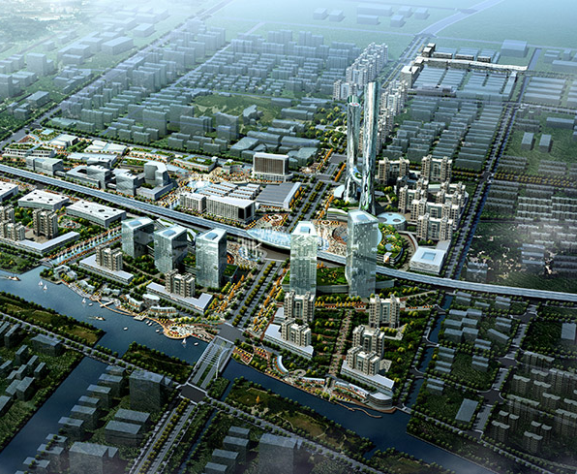
The future of the building lifecycle
The relationship between digital systems and connected physical things will only increase and strengthen
BIM empowers owners to capitalize
on the Era of Connection
Compare design and construction alternatives in context
Leverage the Internet of Things for ongoing operations
Use BIM-enabled efficiencies and capabilities as a new baseline for owners
Notes:
BIM empowers owners to capitalize on the Era of Connection and leverage the Internet of Things for ongoing building operational and maintenance improvements.

Slide 14
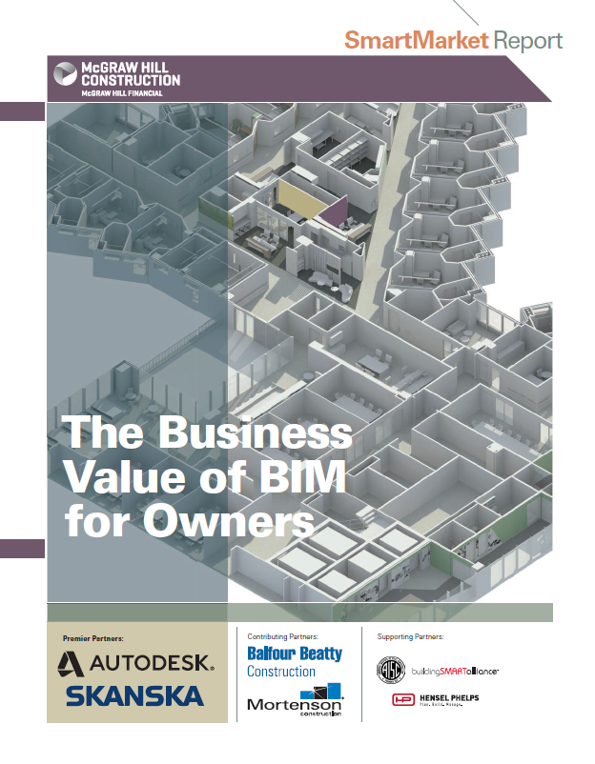
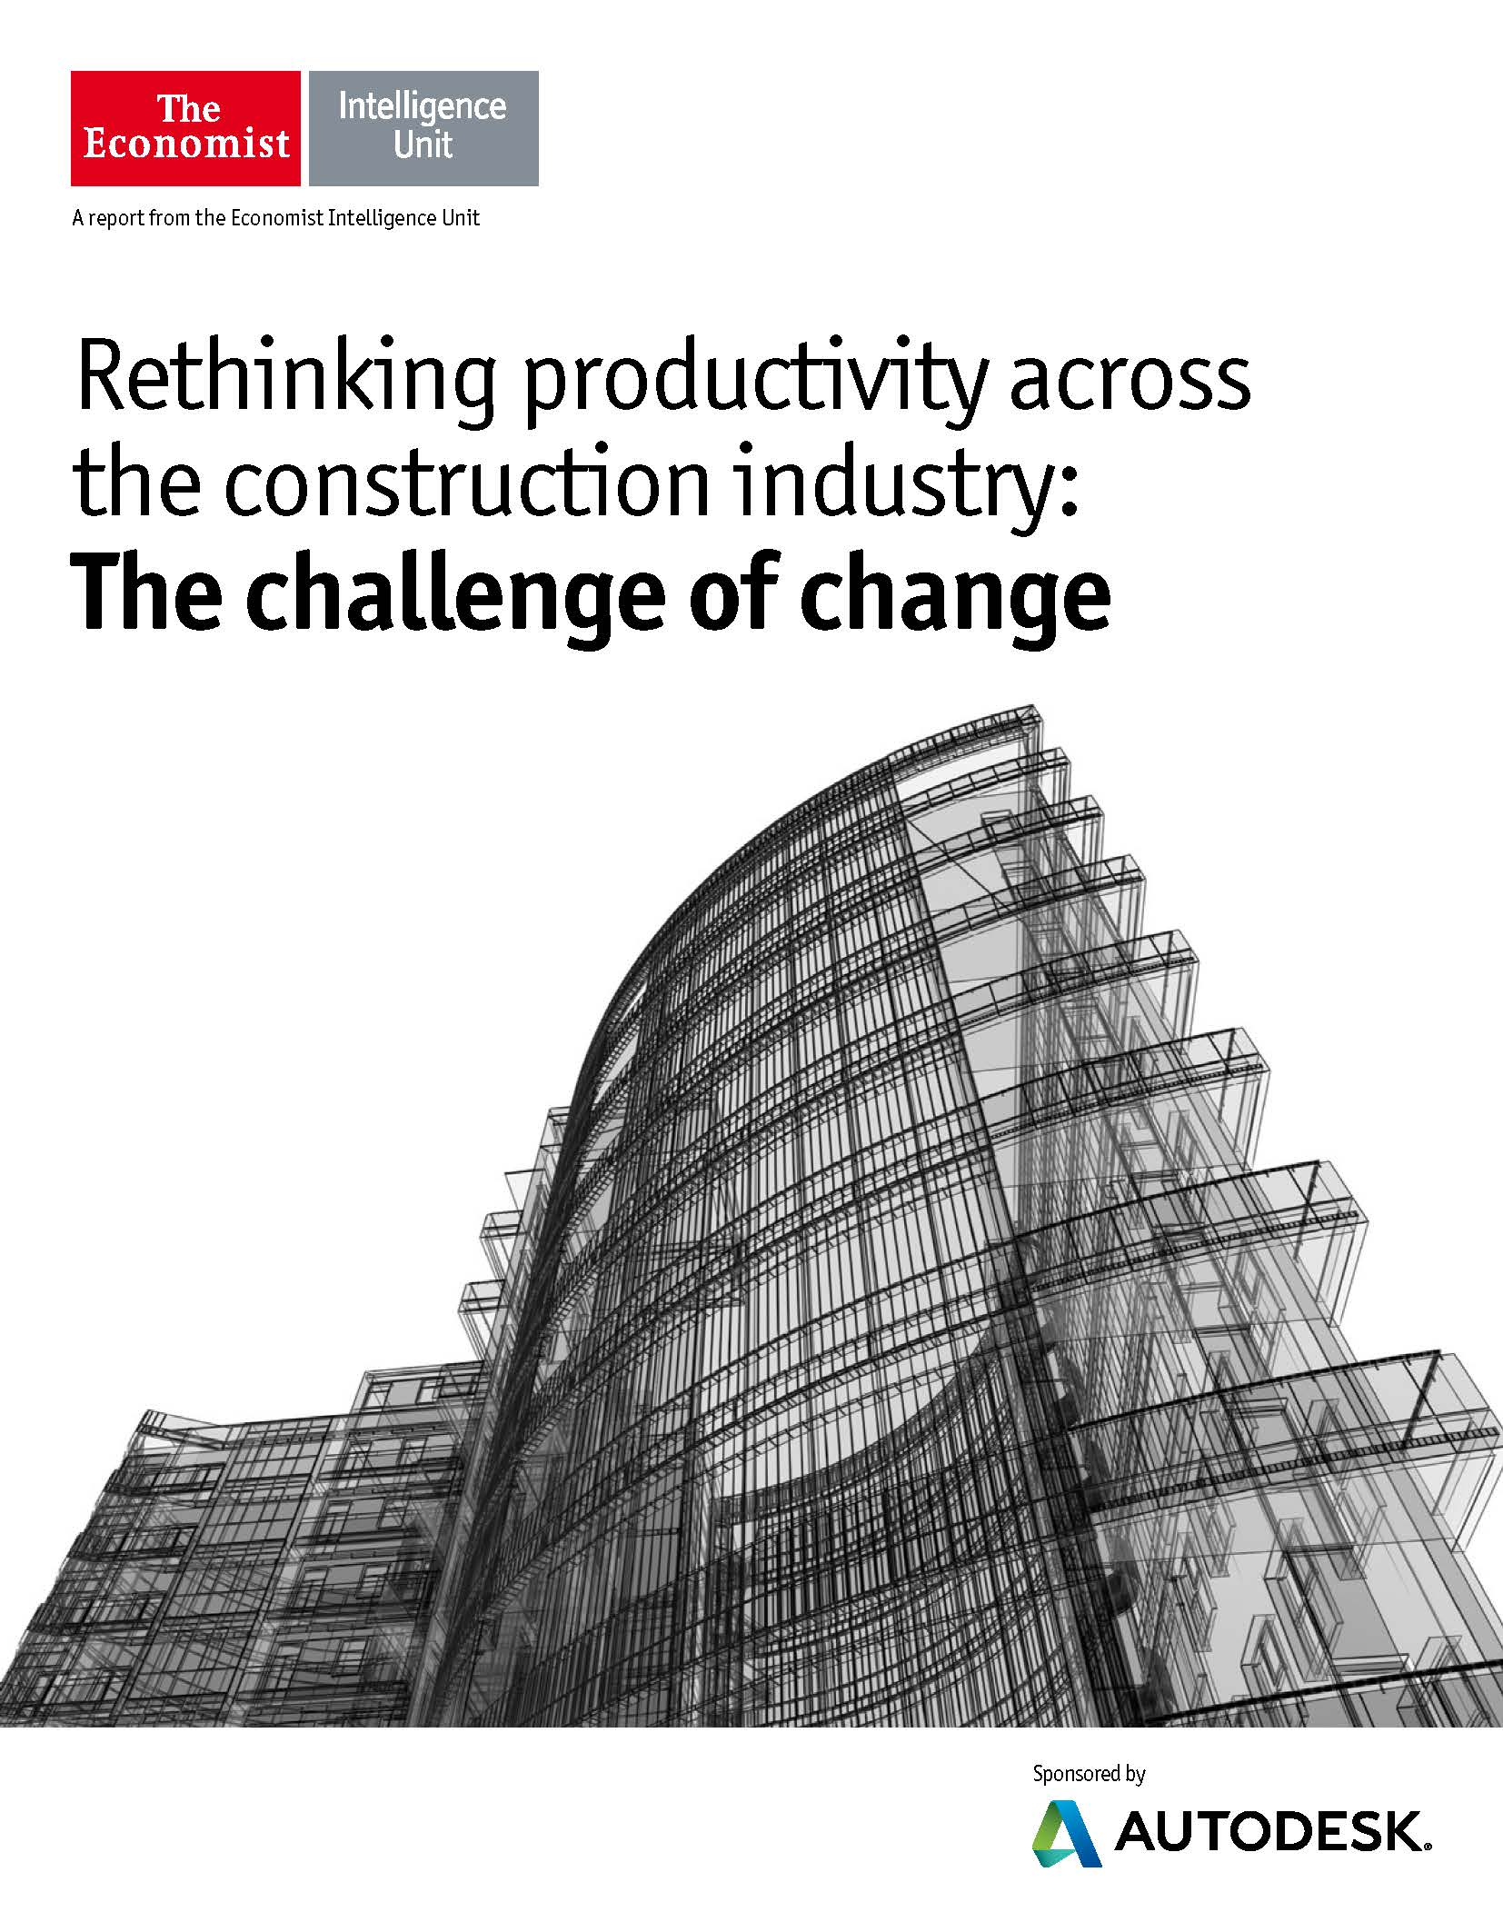
Learn more
Download the McGraw-Hill Construction Smart Report.
Download the Economist Intelligence Unit report.
Notes:
BIM empowers owners to capitalize on the Era of Connection and leverage the Internet of Things for ongoing building operational and maintenance improvements.
McGraw Hill Report:
http://i2sl.org/elibrary/documents/Business_Value_of_BIM_for_Owners_SMR_(2014).pdf
Economist Report:
http://static-dc.autodesk.net/content/dam/autodesk/www/solutions/building-information-modeling/construction/EIU_Autodesk_Construction_WEB.pdf

